Slide 1
Technology Review
Car2Know

Slide 2
Urllib2 Package

Slide 3
Background
The urllib2 module defines functions and classes which help in opening URLs (mostly HTTP) from car2go’s api
Using Request, urlopen function to fetch data
Storing the data in a txt file named the data’s date

Slide 4
Using urllib2
urllib2.Request:
request = Request("http://www.car2go.com/api/v2.1/vehicles?loc=" + city + "&oauth_consumer_key=" key "&format=json")
urllib2.urlopen:
response = urlopen(request)
return response.read()

Slide 5
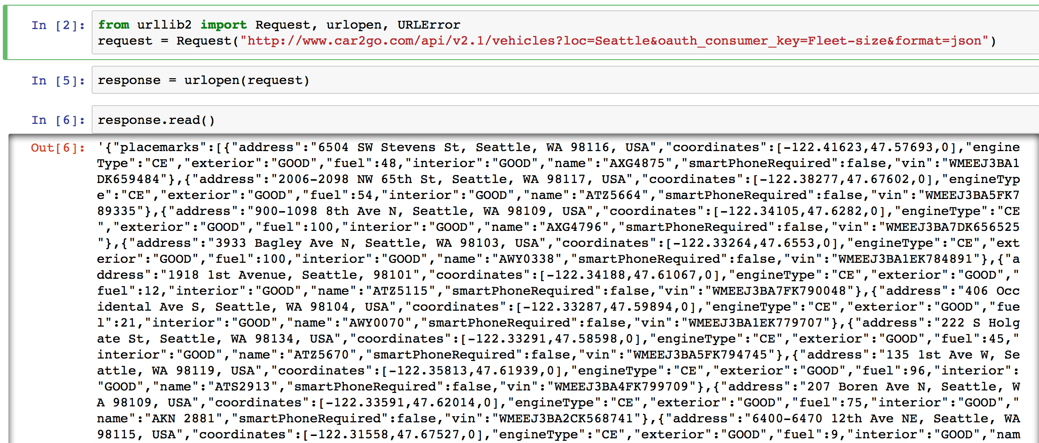
Request Results
Store the data in txt file

Slide 6
Assessment of urllib2
Appeal
--Very easy to use and store the data
--Could request with high frequency: twice per minute
Drawbacks
--Have to run all the time to request the data

Slide 7
Arcpy Package

Slide 8
Background
Need access to ArcGIS data
Perform geographic data analysis, data conversion and map automation

Slide 9
Using ArcGIS/Arcpy
Import Car2Go data into ArcMap:
Transform the projection system into ‘GSC North American 1983’
Clip the map size to a proper range

Slide 10
Using ArcGIS/Arcpy
2. Merge the Car2Go dataset with the Census Block:
Intersect 2 datasets
Distribute the cars to the blocks

Slide 11
Using ArcGIS/Arcpy
3. Analyze the data:
Count the cars in per block
Get the influx and outflux
Output the data

Slide 12
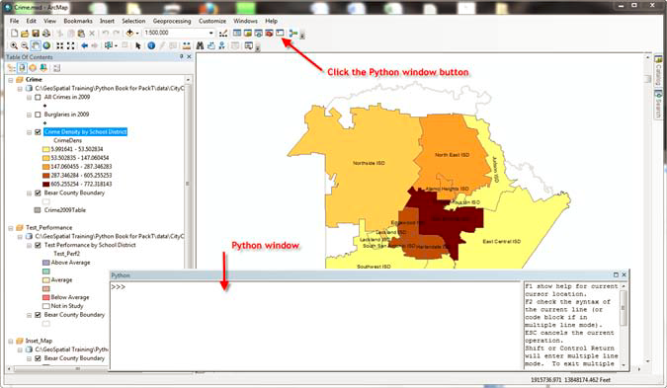
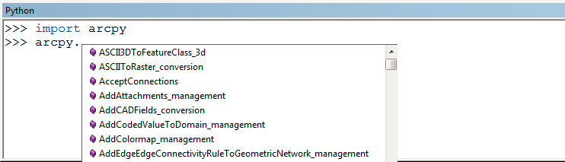
How Arcpy works

Slide 13
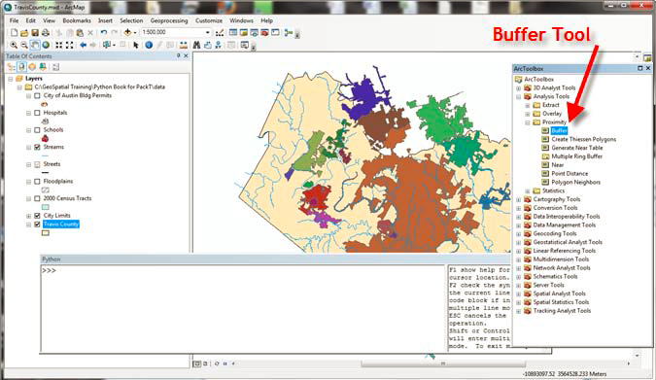
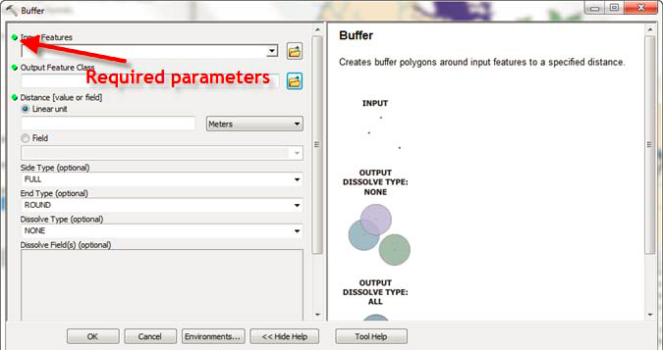
How Arcpy works

Slide 14
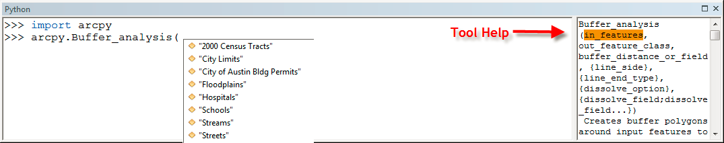
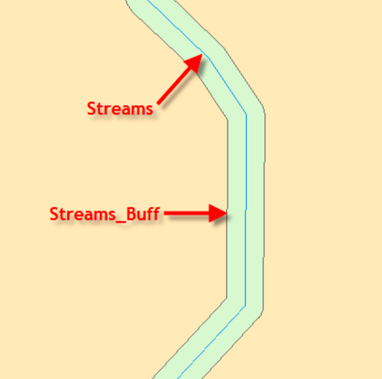
How Arcpy works

Slide 15
Assessment of Arcpy
Appeal
--strong spatial analysis ability
--good visualization of each step
Drawbacks
--the code is complicated (many setting values)
--has to be performed in ArcMap

Slide 16
Data visualization
matplotlib basemap toolkit
Appeal
a library for plotting 2D data on maps in Python
transform coordinates to map projections
read shapefile attribute format (.dbf) file
Drawbacks
how to load ArcGIS data

Slide 17
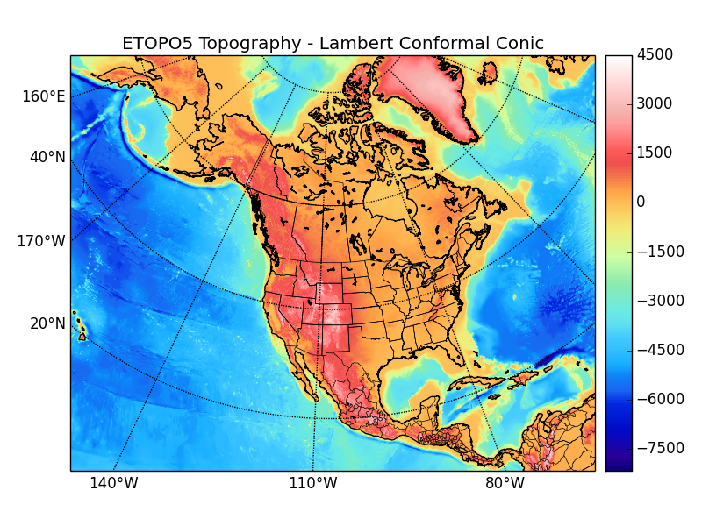
matplotlib basemap toolkit
from mpl_toolkits.basemap import Basemap
…..
arcgisimage(server='url', service=' ', xpixels=400, ypixels=None, dpi=96, verbose=False, **kwargs)
Retrieve an image using the ArcGIS Server REST API and display it on the map.

Slide 18
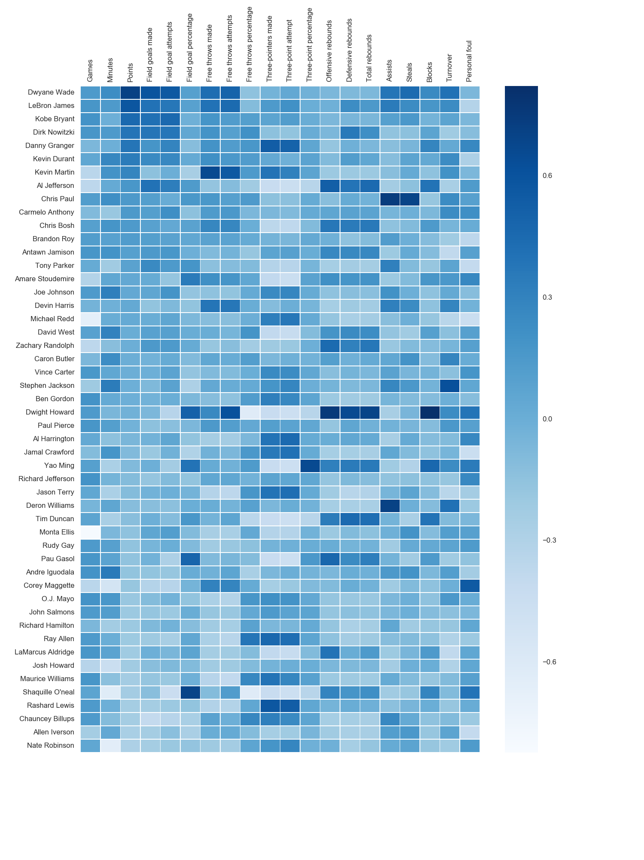
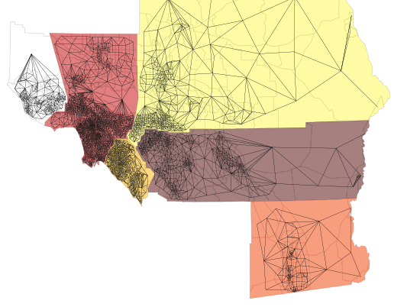
PySAL Python Spatial Analysis Library
import pysal
spatial analysis functions
spatial weights
spatial autocorrelation
Notes:
PySAL is an open source library of spatial analysis functions written in Python intended to support the development of high level applications.

